Slide 1
The Nuts and Bolts of Java
Data types, operators and statements

Slide 2
Primitive data types and their range
Primitive data types are basic data types.
Integer type: byte, short, int, long
Floating point types: float, double
Character data types : char
Boolean data type: boolean

Slide 3
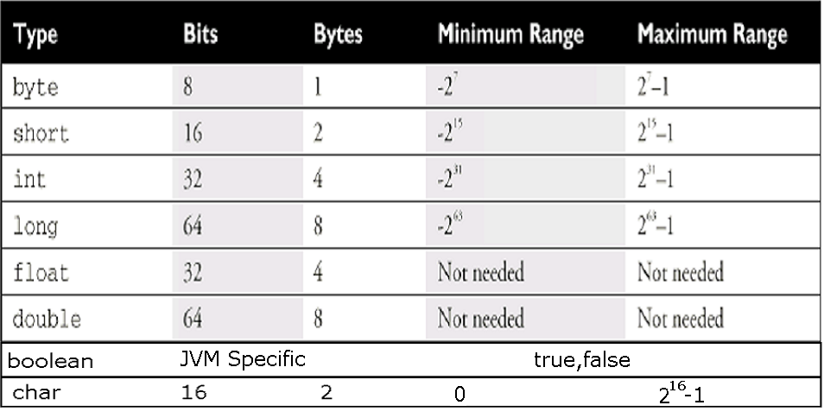
Ranges of Primitive Numbers
(typically 1 byte)

Slide 4

Unicode Character
UNICODE is a 16 bit character.
They are generally represented in hexadecimal format
“\u” in beginning of the character is used to represent hexadecimal character.
The characters represented include all basic English letters, numbers, special characters and characters from other languages also !
For example, Character ‘A’ represented in Unicode as ‘\u0041’ – which is the number 65 in base 10.
You could write the entire java code as
\u0069\u006e\u0074 \u0061;
This above code represents
int a;

Slide 5
Variables
Variable name must begin with a character after which it can be sequence of letters/digits.
Characters like- A-Z, a-z, _,$, or letters of other languages supported by unicode character set.
Digits: 0-9 or any unicode that represents digit.
Length of the variable name is unlimited
Java reserved words should not be used as variable names.

Slide 6
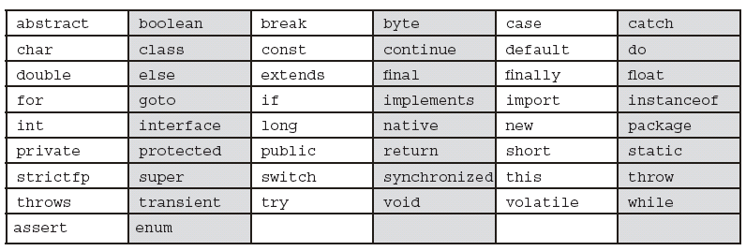
Keywords/ Reserved words
goto and const are unused keywords. They are reserved for future use.
null, true and false are not keywords. However, they cannot be used as identifiers.
Java classes are not keywords.

Slide 7
Constants
Value of a constant cannot be changed once assigned.
final double PI=3.14;

Slide 8


Conventions
Writing code that follows conventions makes methods easy for others to identify in your code.
Java naming conventions
  variable and method name must begin with lower case and start each subsequent word with an upper case letter.
  Class name must begin with uppercase.
  Constants must all be in upper case.
But how can we distinguish variable name from method name?
Method names are verbs while variable names are nouns.

Slide 9
Literals
A literal is the value assigned to a variable. For example 7 is a literal.
The literals available in java:
  Integer Literal
  Floating Point Literal
  Character Literal
  Boolean Literal
  String Literal

Slide 10
Integer Literals
Integer literals are by default int (32 bits).
There are four ways to represent integer numbers in the Java language:
        decimal (base 10): int a = 10;
        octal (base 8) - int seven = 07;
        hexadecimal (base 16)- int x=0xf; (or int x=0xF;)
        long literals: long x = 4000000000L;(or long x = 4000000000l;)

Slide 11
Floating-Point Literals
Floating-Point literals are by default double. double (64 bits).
They can be represented as
  32.4, .24
  3E1, 3e-1
  32.4D , 3E1D, 3e-1D 32.4d , 3E1d, A suffix of D or d also could be added to improve readability for double literals.
  32.1F , 32.1f
Guess what happens if you compile :
float f = 32.3;

Slide 12
Character Literals
1. Character Literal:
'a‘, or '@’
2. Unicode Character Literal:
'\u0041'; // The letter A
3. Escape Sequences Literals:
‘\n’ (enter key), ‘\t’ (tab key)
4. Octal character literals:
'\101’ (A)

Slide 13
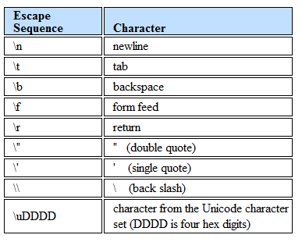
Escape Sequence
\DDD
Character from the Unicode characters
set (DDD is octal digits)

Slide 14
Boolean literals
        true
        false
String literals
        “Bill Joy”
        “Thank You”
        "\u0041“ (A)

Slide 15
Variable Declarations
Local declarations
  Declarations made inside a method
  A local variable must always be initialized to a value before it can be used in calculations or display.
  If a variable is used without initialization, compiler will flag an error.
Class declarations
  Declarations made outside a method
  A class variable is automatically assigned a default value if it is not initialized.

Slide 16
public class Student {
public String name;
public int rollno;
public void display(){
String title ;
System.out.print(title);
System.out.println(name);
title=“Roll No.:”;
System.out.print(title);
System.out.println(rollno);}}}
Or String name=“”;
Class declarations
=“Name:”
Local declaration
Must be initialized
Otherwise you get compilation error !

Slide 17
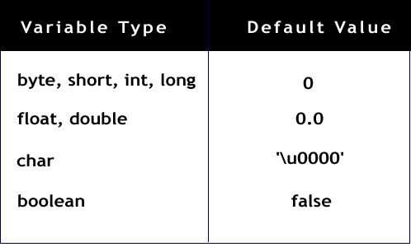
Default Values
String/
any other Object
null

Slide 18

Arithmetic Unary Operators
+ - ++ --
Examples: –5, +5
Pre-increment: y=++x; //(x=x+1; and y=x;)
Post-increment: y=x++; //(y=x; and x=x+1;)
char ch=‘X’;
ch++; // (ch = ‘Y’)
byte c=10;
byte c1=-c;
Error : possible loss of precision
byte c2=++c1;
But
byte c2=c1+1; //same error

Slide 19
Arithmetic Binary Operator
+ - * / %
Example:
int a = 5; int b = 2; int c = a + b;
System.out.println(5%2); // output is 1
remainder operator

Slide 20
Relational Operators
< > >= <= == !=
Example:
int i=10;
int j=20;
System.out.println( i>j );
// output is false
System.out.println(i==10);
// output is true

Slide 21
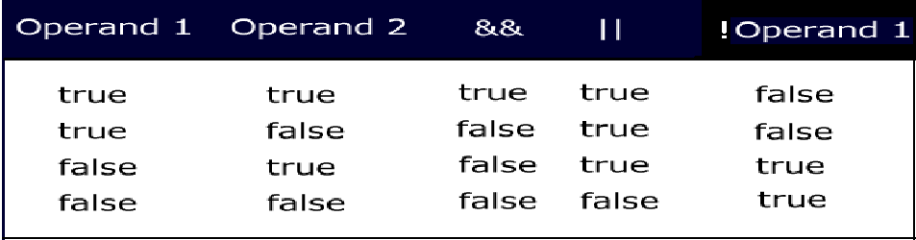
Conditional Logical Operators
&& || ! ?:
Logical operators are binary operators that require boolean values as operands.
Does not work if the operands are int

Slide 22
Short circuit operators
&& and || are also called short circuit operators because they are optimized.
&& checks if the first condition is false. If it is so then it doesn't evaluate the second condition.
|| checks if the first condition is true. If it is so then it doesn't evaluate the second condition.

Slide 23
Example for || :-
int i=0;
int j=10;
System.out.println( i>j || j>i ); // true
Example for ! :-
int i=0;
int j=10;
System.out.println(! (i>j)); // true
//Example for && :-
public class Example{
public static void main(String args[]){
int i=0;
int j=2;
boolean b= (i>j) && (j++>i);
System.out.println(j);
}
}
Guess what is the result of this code ?

Slide 24
Ternary operator
Syntax of ?:
<variable> = (boolean expression) ? <value to assign if true> : <value to assign if false>
Example :-
int i=0; int j=10;
int k=(i>j)?10:20;
System.out.println(k); // outputs 20

Slide 25
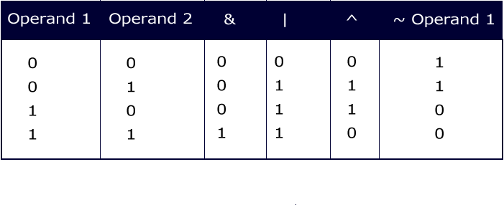
Integer Bitwise Operators
~ & | ^
They convert the integral datatypes into their binary form and then perform operations according the table.

Slide 26
public class AndOrNotEx{
public static void main(String str[]){
byte x=1; // 0000 0001
byte y=3; // 0000 0011
System.out.println(x&y); // prints 1
System.out.println(x|y); // prints 3
System.out.println(x^y); // prints 2
System.out.println(~x); // prints -2
}
}

Slide 27
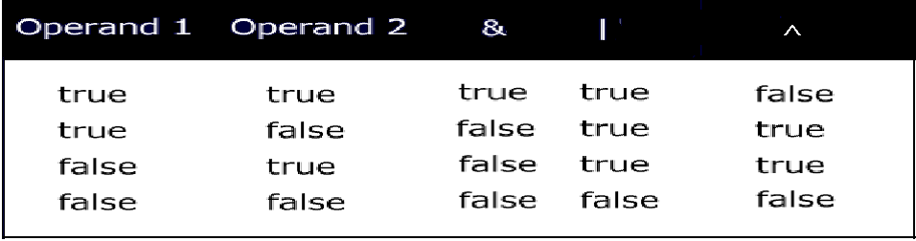
Logical Operators
& | ^
What will happen when you compile the following statement:
if(~(1>2)) System.out.println(“OK");

Slide 28
Comparing conditional and logical operators
public class Example{
public static void main(String args[]){
int i=0;
int j=2;
boolean b= (i>j) & (j++>i);
System.out.println(j); //prints 3
}}

Slide 29

Compound Operators
+= -= *= /= %= &= |= ^=
Example:
int a = 10;
int b=2;
a+=b; // means a=(int)(a+b);
Similarly
byte b=10;
b+=1; // means b=(byte)(b+1);
byte b=10;
b+=1; // no error
But
b=b+1; // error

Slide 30
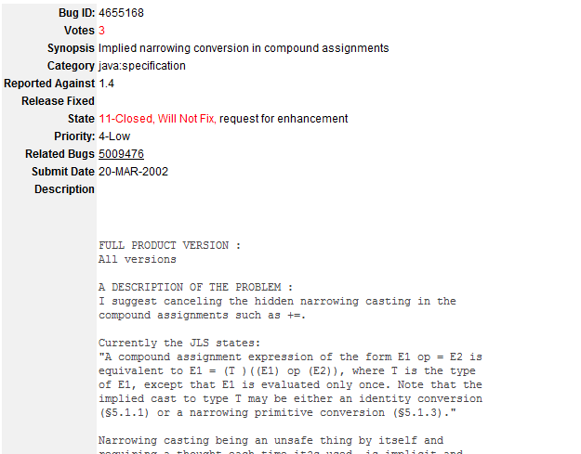

Slide 31
Shift operators
>> the SHIFT RIGHT operator
<< the SHIFT LEFT operator
>>> the UNSIGNED SHIFT RIGHT operator
System.out.println(2<<1);
System.out.println(-1>>2);
System.out.println(-1>>>2);
Result of execution
4
-1
1073741823
Find out what happens if you try to shift more than the number of bits in an int ?

Slide 32
Precedence
Operators Associativity
-------------------------------------------------------
[] . () methodCall() left to right
! ~ ++ -- - + new (cast) right to left
* / % left to right
+ - left to right
>> >>> << left to right
< > <= >= instanceof left to right
== != left to right
& left to right
^ left to right
| left to right
&& left to right
|| left to right
?: left to right
= += -= *= /= >>= <<= >>>= &= ^= |= left to right

Slide 33
Conversions
Widening Conversions (achieved by automatic or implicit conversion)
Narrowing Conversions (achieved by casting or explicit conversion)
Overall magnitude not lost
All primitives are convertible to each other except for boolean.

Slide 34
Automatic or implicit conversion
The conversion in the direction indicated happens automatically.
byte->short->int->long->float->double
char
There could be loss of some information during conversion of the following:
a) int → float b) long→float
c) long→ double
int i=76543210;
float f= i; → 7.6543208E7

Slide 35
Arithmetic operation
When an arithmetic operation happens between different numeric types, the result of the operation is always of the higher numeric data type.
If an arithmetic operation happens between any integer type except long, the result is an int.

Slide 36

Examples of implicit conversion
int i=10; int b=10;
int k=i+b; // ok
2.byte b1=20; short s=10; // ok
But byte b=39078; → error
3.byte b1=20, b2=30;
int i=b1+b2; // ok
But byte b=b1+b2; → error
Same is the case with short
4.byte b=b+1; → error
But byte b+=1; // ok
5. int b=10; byte b1=b; //error
But final int b=10; byte b1=b; //ok
nuances
Complier

Slide 37
Explicit conversion or casting
Any conversion between primitives (excluding boolean) that is not possible implicitly can be done explicitly.
Conversions like (a) double to long, (b) char to byte etc.
int k=10;
byte b=k; // error
If we are ok if we explicitly cast it.
byte b=(byte)k; byte b=(byte)128;
What will be the value when you print b?

Slide 38
Conversions involving char and integral types
char c=‘A’;
int i=c; // 65(unicode value)
char c=65;// ok 65
int ii=65;
char c=ii; //error
char c=(char)ii;// casting
short s=c ; // error
short s=(short)c;
Though short and char are 16 bits! Why? Why should compiler not allow this?

Slide 39
Conditional Statements
if (condition) statement(s)
[else statement(s)] ;
switch (expression){
[case expression: statement(s)]
…
[default: statement(s)] }
switch(x){
case 10:
case 20: System.out.print(“10 or 20”);
break;
case 30: System.out.print(“30”); break;
default: System.out.print(“default”);}
Example

Slide 40
Loops
for(initialization;condition;iteration) statement(s);
while(condition) statement(s);
do statement(s) while(condition);
break;
continue;

Slide 41
Examples
class Prime{
/*
This program checks if a number is a prime number. */
public static void main(String str[]){
int num = 5;
int j=num/2;
boolean flag=true;
Initializing variables. num is the number being tested for “prime-ness”.

Slide 42
Notice the way i is initialized in the for loop. i is not available outside the for loop.
for (int i=2;i<=j;i++){
if(num%i==0){
flag=false;
System.out.println("Not prime”);
break; }
else continue; }
if (flag)
System.out.println("Prime number");
}
}

Slide 43
Labeled continue/break statements
Example:
first: for(int i=0;i<2;i++)
for(int j=1;j>0;j--)
if(i!=j)
continue first;
else
System.out.println(i+j);
//prints 2
When i=0 and j=1
In cases where there are more than one loop, break and continue statement can be used with labels to indicate from which loop should it break or continue.

